Slide 1
2D Viewing Transformation
& Clipping
Sunirmal Khatua
Department of Computer Science & Engineering
University of Calcutta

Slide 2
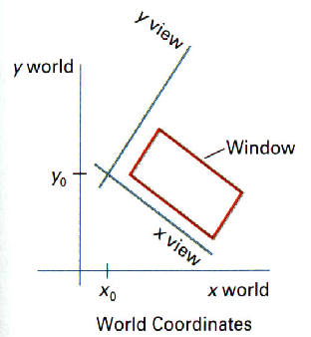
Basic Definitions
World Coordinate Frame.
Viewing Coordinate Frame.
Device Coordinate Frame.
Window.
Viewport.
y device
Viewport
x device

Slide 3
Viewing Transformation Pipeline
World Coordinate
to
Viewing Coordinate
MC
Construct World Coordinate Scene
WC
VC
Viewing Coordinate
To
Normalized VC
Normalized VC
To
Device Coordinate
DC
NVC

Slide 4
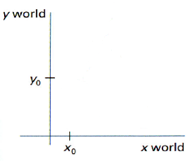
WC-VC Transformation
Translate to World Coordinate Origin.
Rotate to align with World Coordinate.
M_{WC,VC} = R(ɵ). T(-x₀,-y₀)
y view
x view

Slide 5
Window to Viewport Transformation
yw_{max}
yv_{max}
(xw,yw)
(xv,yv)
yw_{min}
yv_{min}
xw_{min}
xw_{max}
xv_{min}
xv_{max}
M_{window,viewport} = T(xv_{min},yv_{min}) . S(s_{x}, s_{y}) . T(-xw_{min},-yw_{min})
xv_{max} – xv_{min}
s_{x} =
xw_{max} – xw_{min}
yv_{max} – yv_{min}
s_{y} =
yw_{max} – yw_{min}

Slide 6
Clipping
The operation of finding the portion of a picture that is outside or inside a specified region is called Clipping.
The region is generally a rectangle in shape, called Clipping Window and is specified by the end points (xw_{min}, yw_{min}) & (xw_{max}, yw_{max}) .
The algorithm used for clipping is called Clipping Algorithm.
We will discuss the following Clipping Algorithms:
  Point Clipping
  Line Clipping
  Polygon Clipping

Slide 7
Point Clipping
xw_{min} <= x <= xw_{max}
yw_{min} <= y <= yw_{max}

Slide 8
Line Clipping
Cohen-Sutherland Line Clipping Algorithm.
Every end-point is given a code, called region code relative to the clipping window.
struct region_code{
boolean l,r,t,b;
}
Nothing
Remove
Clip One End
Clip Both Ends
1010
0010
0110
1000
0000
0100
1001
0001
0101

Slide 9
Line Clipping (cont.)
Given a point P and a window W, we can encode the point as:
region_code encode(P, W){
region_code C;
C.l = (P.x < WX_{min});
C.r = (P.x > WX_{max});
C.t = (P.y < WY_{min});
C.b = (P.y > WY_{max});
return C;
}
Test for trivial acceptance & trivial rejection:
  A line can be trivially accepted if the code of both the end points are 0000.
  A line can be trivially rejected if the logical AND of the codes produces non-zero result.
1010
0010
0110
1000
0000
0100
1001
0001
0101

Slide 10
Line Clipping (cont.)
If not trivially accepted or rejected, divide the line segment into two at a clip edge.
Continue the process for every clip edge until the line segment is trivially accepted or trivially rejected.
P1.x = WX_{max}
P1.y = P1.y + (WX_{max} – P1.x) . m
Special Case : m = ∞
P1.x = P1.x
P1.y = WY_{min} or WY_{max}
P₁
P₁
P₂

Slide 11
Polygon Clipping
Sutherland-Hodgeman algorithm (A divide-and-conquer strategy)
  Polygons can be clipped against each edge of the window one at a time. Edge intersections, if any, are easy to find since the X or Y coordinates are already known.
  Vertices which are kept after clipping against one window edge are saved for clipping against the remaining edges.
  Note that the number of vertices usually changes and will often increases.

Slide 12





Polygon Clipping(cont.)
Inside
Outside
Inside
Outside
v_{i+1}
v_{i}
v_{i}
Case 3 (out → out)
v_{i+1}: output
Inside
Outside
i: first output
Case 1(in → in)
v_{i+1}: second output
v_{i}
v_{i+1}
v_{i}
i: output
Inside
Outside
Case 2(in → out)
Case 4(out → in)

